Slide 1
Foundation of Data Science: Project Report
Victor Peterson

Slide 2
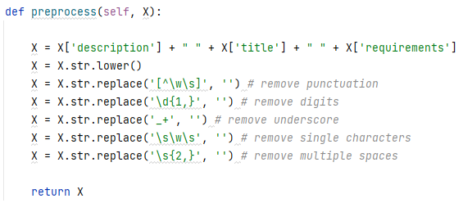
Preprocessing
Used ‘description’, ‘title’, ‘requirements’
Removed punctuation, digits, underscores, single characters, multiple spaces
Removed the rest of the columns

Slide 3
Preprocessing
Featurization
Remove stop words
L2 normalization on rows
Enable inverse-document-frequency reweighting
Smooth idf weights by adding one to document frequencies
Considered 1-gram up to 4-gram

Slide 4
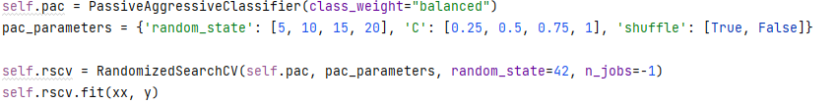
Model Training
Passive Aggressive Classifier
Hyperparameter tuning with Randomized Search CV

Slide 5
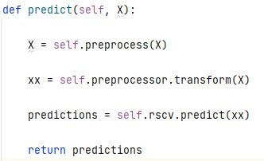
Prediction
Apply the preprocessor and learned model to predict whether a posting is fake or not.

Slide 6

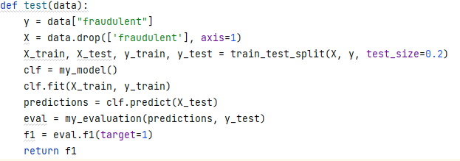
Model Evaluation

